Slide 1
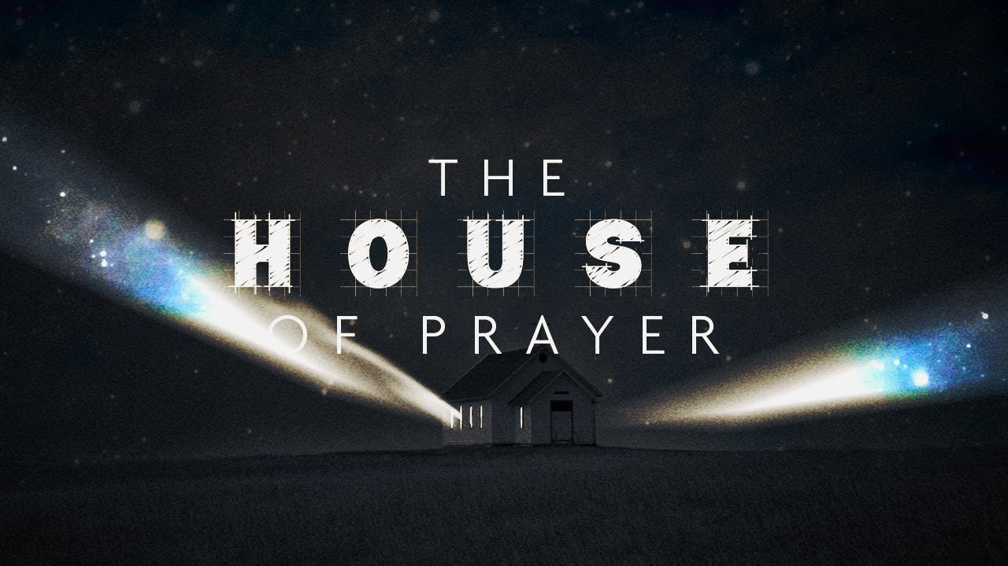
The Birth of Samson
Wednesday Night
Judges 13

Slide 2
Now Samson went down to Timnah and saw a woman in Timnah of the daughters of the Philistines. So, he went up and told his father and mother, saying, "I have seen a woman in Timnah of the daughters of the Philistines; now therefore, get her for me as a wife."
Judges 14:1-5

Slide 3
Then his father and mother said to him, "Is there no woman among the daughters of your brethren, or among all my people, that you must go and get a wife from the uncircumcised Philistines?" And Samson said to his father, "Get her for me, for she pleases me well.”
Judges 14:1-5

Slide 4
But his father and mother did not know that it was of the LORD—that He was seeking an occasion to move against the Philistines. For at that time the Philistines had dominion over Israel.
Judges 14:1-5

Slide 5
Samson is a walking tension: God’s sovereign purpose riding on unstable human character.
“God writes straight lines with crooked sticks — and Samson was a crooked stick with big muscles.”
“…a man of splendid powers and gross weaknesses.” (Morgan)
Introduction

Slide 6
“I have seen a woman…”
Eve - Gen 3:6; Achan - Jos 7:21
Mat 5:29, 1Jn 2:16
Samson is operating by appetite, not covenant.
Judges 14:1-2

Slide 7
“For she pleases me well.” - Lit: “She is right in my eyes.”
Echoing the moral slogan of the entire book:
“Everyone did what was right in his own eyes.” (Judges 21:25)
Judges 14:1-2

Slide 8
“I am my own moral authority.” suggests:
Personal perspective is final
But - (Pro 14:12)
Morality is fluid and self-serving
But - (Jer 17:9)
It eliminates any basis for justice
Judges 14:1-2

Slide 9
Covenant Compromise: Intermarriage often led to spiritual corruption (cf. Deut 7:3–4).
Do not be unequally yoked together with unbelievers.
2Co 6:14-15
Be in the world, but not of the world.
Judges 14:3

Slide 10
“Get her for me…”
Imperative command: “Just do it!”
2Pe 1:3-8
“Samson had the strength to tear apart a lion — but not the restraint to tell his own desires ‘no.’”
Judges 14:3

Slide 11
“But his father and mother did not know that it was of the LORD…”
God did not cause Samson’s sinful desire but did sovereignly use it.
Samson acts from flesh; God acts from purpose.
Both are true at once
Judges 14:4

Slide 12
Pattern
Joseph (Gen 50:20), Judas (Acts 2:23)
Human intention and divine sovereignty operate on different levels at the same time.
Judges 14:4

Slide 13
God empowers him for deliverance. But Samson is already drifting in discipline.
“…the honey in the carcass was more dangerous than the lion in the path.” (Meyer)
Judges 14:5-9

Slide 14
“Walk in the Spirit, and you shall not fulfill the lust of the flesh.” (Gal 5:16)
“If we live in the Spirit, let us also walk in the Spirit.” (Gal 5:25)
Samson is experiencing moments of Spirit empowerment without demonstrating consistent Spirit-governed living.
Judges 14:5-9

Slide 15
Samson is entering their social world.
He is alone in enemy territory; he is being absorbed into their culture.
The deliverer of Israel is socially surrounded by the oppressor.
Judges 14:10-11

Slide 16
“Let me pose a riddle to you…”
Samson’s character:
Competitive, Provocative & Cocky
Confident to the point of arrogance
Judges 14:12-14

Slide 17
“Let me pose a riddle to you…”
He Turned a Sacred Moment into a Wager; a Spirit-enabled victory into ego-fueled competition.
Acts 8
The gift becomes platform - The miracle becomes currency.
Judges 14:12-14

Slide 18
“She pressed him…”
Relentless urging.
“…you plowed with my heifer…”
“You used my cow!”
Judges 14:15-18

Slide 19
“Then the Spirit of the LORD came upon him mightily…”
Divine empowerment for deliverance, not moral approval.
Again, we see the doctrinal tension:
Samson acts from flesh; God acts from purpose.
Both are true at once.
Judges 14:19-20

Slide 20
Leadership Warnings
You can be empowered for impact while being governed by emotion.
Giftedness does not equal maturity.
reflections

Slide 21
Leadership Warnings
You can win battles and lose intimacy.
Victory in public does not guarantee health in private.
reflections

Slide 22
Leadership Warnings
You can fulfill obligations and still fracture relationships.
You can “do ministry” and still wound the people around you.
reflections

Slide 23
The Character of Samson
Wednesday Night
Judges 14

